Slide 1
SUSTAINABLE ECONOMIC TRANSFORMATION IN THE CONTEXT OF SDGs
GODFREY KANYENZE
PRFT ECONOMIC TRANSFORMATION POLICY DIALOGUE WORKSHOP
HOLIDAY INN
12 SEPTEMBER 2016

Slide 2
STRUCTURE OF PRESENTATION
  1.0 CONCEPTUAL FRAMEWORK
  1.1 DUAL & ENCLAVE ECONOMY.
  1.2 STRUCTURAL ECONOMIC TRANSFORMATION
1.3 ROLE OF AGRICULTURE IN ECONOMIC TRANSFORMATION
2.0 STRUCTURAL REGRESSION IN ZIMBABWE
3.0 WAY FORWARD

Slide 3
The Legacy of a Dual & Enclave Economy
The Zimbabwean economy, like most Southern African economies, was largely shaped by the ideology of white supremacy and patriarchy that characterised the period 1890-1979.
Through this ideology, a dual and enclave economy was created, through which a relatively developed and diversified formal economy co-existed with a largely neglected and underdeveloped peasant-based rural economy.
This dualism reflects the grafted form of capitalist relations of production onto a hitherto traditional economy at the time of colonisation.
Thus, the capitalist sector captured a part of the economy, the formal sector, leaving the non-formal sectors under pre-capitalist social formations.
The inherited economy had a relatively developed and diversified economy by African standards.
An often used measure of development is the share of agriculture and industry in the economy.
With increasing levels of development, the industrial sector’s role rises relative to that of agriculture and vice versa.
The contribution of agriculture to GDP at only 12.2% for Zimbabwe was much lower than the average level for Sub-Saharan Africa (SSA) of 31.6% between 1980 and 1989.

Slide 4
On the other hand, by 1980, the manufacturing sector was already the largest contributing sector to GDP at 25% in Zimbabwe, compared to an average of only 10.4% for SSA over the period 1980-1989 and 23.3% for Zimbabwe.
As a result of the relative isolation of the Zimbabwean economy caused by the Unilateral Declaration of Independence (UDI), Zimbabwe had developed an economy that produced a wide range of agricultural and manufactured products for the domestic market and which managed, in spite of sanctions, to export agricultural and mining products.
Apart from its relative size, the manufacturing sector was diversified such that at the advent of independence, industry already consisted of some 1,260 separate units producing 7,000 different products.
This relatively high level of economic diversification is also reflected in the relatively broad export base, with agriculture accounting for 41% of export earnings in 1984, followed by manufacturing at 32% and mining (27%).
Thus, the economy that the new independent state inherited was far from the typical mono-cultural economy that most SSA economies are.
Out of the 37 African countries whose trade statistics are reported in the 1997 World Development Indicators, 31 derive in excess of 70% of their export earnings from primary commodities (1993 statistics). Of these, Algeria, Angola, Chad, Congo, Ethiopia, Gabon, Libya, Malawi, Mali, Mauritania, Niger, Nigeria, Rwanda, Sudan and Uganda are the extreme cases, deriving at least 90% of their export earnings from primary commodities.

Slide 5
The perennial problem of under-utilisation of resources, implying underdevelopment, can be traced to the legacies of the African economies.
Underdevelopment in Africa is a reflection of the imbedded economic dualism that is associated with the grafted type of capitalism that was carved out under colonialism.
Thus, the low resource absorptive capacity of African economies is related to the enclave growth emanating from the structural legacy of economic dualism which explains the vicious circle of perpetual under-employment that afflicts the majority of the labour force, and especially women.
The evolving social formations suggest the co-existence of the dominant capitalist and pre-capitalist modes of production that have been fused together in a rather uneasy and tenuous co-existence (grafted capitalism).

Slide 6
From the capitalist perspective, pre-capitalist forms of work constitute non-productive labour in that the labour is not profit-oriented.
From a market, and therefore capitalist point of view, under-employment manifests itself as non-productive labour in that it is not harnessed by capital for accumulation.
The capitalist part of the economy is the formal sector, while the pre-capitalist part is the non-formal sector (informal and subsistence sectors).
The non-formal sector therefore accommodates the remnant of pre-capitalist forms of production (non-productive labour).
An important requirement for development under capitalism is the need to capture non-productive labour into its realm of operation.
This way, a dynamic impulse is imparted to social relations based on the imperative to accumulate.

Slide 7
Thus, the disruption of pre-capitalist relations imparts to a country the potential of internally driven growth.
The issue is that while both developed and developing countries have both elements of productive and non-productive labour, it is the predominance of non-productive labour in developing countries that constitutes the major problem.
In other words, the tragedy in most African economies is that the majority of its labour force, mainly women, is trapped in pre-capitalist forms of production which are not driven by the need to employ labour to generate profit and the further expansion of capital.
Apart from the under-utilisation of resources, and especially labour, another legacy of colonialism is the absence of an internal (endogenous) dynamism for growth and transformation since the economies are dependent on, and constrained by external factors.
In the absence of an internally motivated and conscious process of transformation, the growth process would not only marginalise the majority of the labour force, but would also marginalise the developing country itself in the international arena.

Slide 8
Demand deficiency: An enclave economy will also be limited by the very nature of the system itself: the fact that a large segment of labour force is engaged in low productivity implies that effective demand is low, limiting the market for formal activities to expand.
This deficiency in effective demand also makes the formal economy more reliant on external demand, thereby reinforcing dependency.
Limited internal savings: The fact that a large segment of the labour force cannot engage in productive activities (survivalistic) implies they are not available for accumulation by the capitalist sector.
In addition, the fact that a majority of the labour force lives close to subsistence levels implies that they cannot save and if they do their savings are not captured through financial intermediation due to missing linkages and market gaps in the financial market.
Thus, an enclave economy tends to lack the capacity to generate internal savings hence the reliance on foreign investment and foreign aid which pre-empts the need for self-generated savings.
Asymmetry between National, Regional and International growth and development needs: As a consequence of the above problems, African countries find themselves in a dilemma whereby disarticulations at the national level, coupled with external dependency, militate against effective regional cooperation and national development as well.

Slide 9
The Zimbabwean economy is characterized by dualism, a legacy that has been reinforced by both the colonial & post-colonial policies which had a formal sector bias.
The trickle-down effects from the formal sector are too weak to transform and absorb these sectors into formal activities.
Market forces on their own would simply perpetuate this dualism, even in the presence of some growth.
In this regard, a proactive role of the state is needed to integrate the non-formal economy and endogenise the growth process in a manner that allows the majority of the labour force to be in productive activities.
The strategy recommended involves targeted supply-side measures to resolve market failures through redistribution of productive assets.

Slide 10
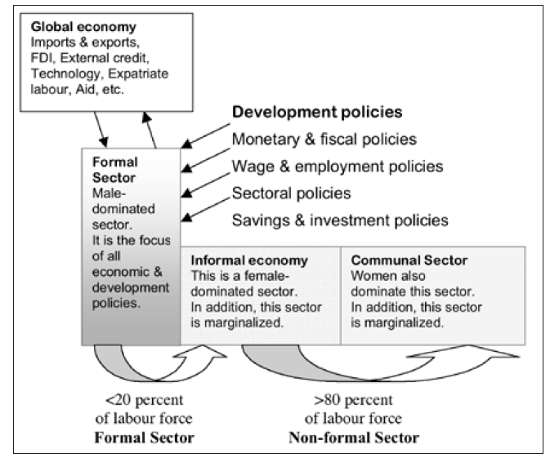
The Dual and Enclave Structure of the Economy

Slide 11
Structural Changes in the Economy: Some stylized facts
The term economic transformation provides an analytical framework to understand and organize the complex and inter-related changes that occur as the material wealth of societies grows.
‘Economic growth’ represents the narrowest conceptualization of this process, focusing almost entirely on measurement.
Concepts such as ‘shared growth’ and ‘inclusive growth’ have emerged in response to the realisation that economic growth does not necessarily lead to poverty reduction or higher income and social equality.
The pattern and quality of growth matters as much as its quantum in the process of structural transformation.
The earliest development economists saw the development of countries' “modern economic growth" happening in terms of three great transformations, in demography (slower population growth and average age rising), production (agriculture declining relatively to manufacturing) and social structure (for e.g. family and kinship based production and distribution to commercialised production and exchange).
Economic transformation results in change in a country’s economic structure, with a shift in resources from low to higher productive sectors or activities.

Slide 12
The reallocation of jobs across sectors is central to the process of structural change and productivity upgrading.
Growth in labour productivity arises either from changes in labour productivity within sectors – for instance through the implementation of new machines and innovative technologies that allow more output with the same amount of labour input – or from the reallocation of jobs across sectors (“structural change”) when workers move from low- to high-productivity sectors (e.g. from agriculture to industry or services);
At the same time, structural change is central and necessary to increase living standards durably and equitably by allowing ever more people to benefit from higher productivity levels in more advanced parts of the economy.
Structural change is the most effective driver of growth to bring down rates of vulnerable employment in developing economies, both in the short and in the long run.
It is the across-sector labour productivity component of growth that is associated strongest with the speed at which vulnerable employment decreases, compared with other growth components.

Slide 13
The role of agriculture in economic transformation
The notion that agricultural development is an integral component and catalyst of wider structural transformation is widely accepted.
Agriculture productivity growth is the foundation for broader structural transformation.
Its importance in economic transformation derives from its role as a major provider of livelihoods and employment for the majority of the population.
Increased productivity in agriculture plays an important role in stimulating growth in the non-agricultural economy.

Slide 14
The mechanisms by which agricultural growth promotes transformation in the wider economy includes:
higher agricultural labour productivity releases labour from agriculture into employment in relatively well remunerated rural and urban non-agricultural sectors;
increased demand for agricultural inputs and services stimulates local production and marketing of inputs and local provision of services;
when smallholders supply agriculture commodity value chains it stimulates commercial distribution and processing activities at the local level;
increased profits and exports from agricultural production finances imports of key technology and capital which can be invested in other sectors, particularly non-farm sectors; and
higher smallholder incomes raise demand for non-food consumer goods and services that boosts the diversification of the rural economy through a variety of multiplier effects.

Slide 15
The transformation of the agriculture sector, from a subsistence to a commercial sector, enhances consumption and production linkages between the agricultural and non-agricultural sectors, and between rural and urban areas.
Increased agricultural production creates demand for products and services from the non-farm sector, both “upstream” and “downstream”.
Upstream production linkages “occur where growth in the farm sector induces the non-farm sector to invest in capacity or supply goods and services to the farm sector”.
Downstream production linkages occur when the nonfarm sector is induced to invest in capacity to supply processing and distribution services, using farm products as inputs.
These linkages or multiplier effects contribute to employment creation and rising incomes.

Slide 16
In addition to production linkages, consumption or expenditure linkages may occur when rising farm incomes lead to an increase in the demand for consumer goods and services provided by the non-farm sector.
The strength of the effect depends on the structure of the economy.
Evidence that there are greater development and poverty impacts when agricultural transformation is led by small-scale producers.
Political commitment to agriculture-based development is important: yet only 7 African governments have achieved the 10% Maputo target for agriculture spending.
As a percentage of total vote, Agriculture, Mechanisation & Irrigation Development in Zimbabwe received 8.3% in 2014, 5.3% in 2015 and 3.6% in 2016 against international standard (the Maputo Declaration) of 10% towards agriculture. In 2016, 96.8% of revenues go to employment costs.
In order to upgrade agriculture value chains and infrastructure, African countries should spend at least between 20 and 40% of the budget on agriculture.

Slide 18
Sub-Saharan Africa: Civil Servant Wages in 2013 (percent of government expenditures)

Slide 20
Economic Transformation and Environmental Sustainability
Sustainability,’ defined by the Brundtland Commission report of 1987 as development that meets the needs of the present generation without compromising the ability of future generations to meet their own needs.
Sustainable human development puts people at the centre of the development process, and its central tenet involves the creation of an enabling environment where people can enjoy long, healthy and creative lives.
The global Human Development Report, 1994 added the gender dimension defining SHD as follows (UNDP, 1995: 4):
Sustainable human development is pro-people, pro-jobs, and pro- nature. It gives the highest priority to poverty reduction, productive employment, social integration, and environmental regeneration. It brings human numbers into balance with the coping capacities of societies and the carrying capacities of nature … It also recognizes that not much can be achieved without a dramatic improvement in the status of women and the opening of all opportunities to women.

Slide 21
The Human Development Report, 1996 elaborated on the concept, adding further concepts as follows (UNDP, 1997):
Empowerment – the expansion of people’s capabilities.
Co-operation – the acknowledgement that a sense of belonging brings personal fulfilment, a source of well-being, enjoyment, purpose and meaning. In that case human development embraces ways in which individuals cooperate and interact.
Equity – capabilities and opportunities, and not only income, all of which should be accessible and attained by all.
Sustainability – meeting the needs of the present generation without compromising the ability of future generations to meet their own needs.
Security (especially of livelihoods) – freedom from threats like disease, repression, or dislocations.
This way of looking at development has implications in terms of the role of the State.
Under the human development strategy, the State ought to play a leading and strategic role in expanding capabilities and opportunities, and in ensuring that growth is broad-based and inclusive (shared).

Slide 22
The principles guiding the SHD therefore include the following:
Ethical development that does not violate human rights;
Equity - less disparities between groups;
Inclusion – broad-based approach to growth and development;
Human security – promotion of stability and minimization of the vulnerability of people;
Sustainability - less environmental destruction;
Human development - no poverty and deprivation.

Slide 23
Economic transformation is a widely promoted development priority, but issues of environmental sustainability and climate resilience not been fully integrated into the economic transformation discourse.
Evidence of the impact of social and economic transformation based on synthetic inputs on the sustainability of the environment is clearly negative.
Evidence also shows that environmental degradation is inherent in unregulated economic development.
Threats to sustainable development from climate change and other forms of environmental degradation mean that economic transformation strategies need to incorporate measures to sustain the natural resource base on which future development depends.
Agriculture, the source of livelihood to 70% of the population in SSA, is the most affected by climate change.
Hence, policy makers must consider how to integrate environmental and economic development objectives beyond identifying costs to the environment and managing these – need for innovative thinking to achieve a “green transformation” - “improved human well-being and social equity, while significantly reducing environmental risks and ecological scarcities”.
‘Green economy’, ‘green growth’, green jobs discourse is moving to the center of many national development strategies.

Slide 24
As UNCTAD put it, “...achieving sustainable development in Africa requires deliberate, concerted and proactive measures to promote structural transformation and the relative decoupling of natural resource use and environmental impact from the growth process”.

Slide 25
Structural Regression in Zimbabwe
Since independence in 1980, Zimbabwe has implemented no less than 15 economic blueprints:
Growth with Equity (1981);
Transitional National Development Plan (1982-1985);
First Five Year National Development Plan (1986-1990);
Economic Structural Adjustment Programme (ESAP) (1991-1996);
ZIMPREST (1996-2000);
Millennium Economic Recovery Programme (MERP) , 2001-02;
Ten Point Plan based on Agriculture (2002);
National Economic Revival Programme (NERP) (2003);
Macroeconomic Policy Framework (2005-2006);
National Economic Development Priority Programme (NEDPP) (2007);
Zimbabwe Economic Development Strategy (ZEDS) (2008)(aborted at Conception);
Short Term Economic Recovery Programme (STERP I) (2009-10);
Short Term Economic Recovery Programme (STERP II) (2010-12);
Medium Term Plan (2011-15);
ZimAsset, October 2013- December 2018 & Ten-Point Plan, August 2015
I-PRSP (2016-18) & Sustainable Development Goals (SDGs), 2016-2030.

Slide 26
Mining drives export recovery post-2009 (contribution to export growth - %) - one cylinder is firing (mining)

Slide 27
External trade
Exports are projected at US$3.4 billion in 2015, against imports of US$6.3 billion, resulting in a trade deficit of US$2.9 billion compared to US$2.7 billion in 2014.
The large trade deficit reflects the country’s over-dependence on imports, most of which can be produced locally.
The huge import bill is also fuelled by the continued depreciation of the rand against the US dollar, which lost over 13% of its value against the US dollar since January 2015, undermining the competitiveness of Zimbabwean exports.
Of the US$2 billion export earnings during the period January to October 2015, at least 80% were primary commodities (agricultural products and minerals), while imports amounted to US$5 billion.
A current account deficit of US$2.6 billion is projected in 2015 against US$2.8 billion in 2014; 18.7% of GDP against a SADC macroeconomic convergence target of under 9%.

Slide 29
Export portfolio is less diversified (World Bank, 2012)

Slide 30
Zimbabwe’s falling diversification contrasts starkly with other African countries (World Bank, 2012)

Slide 31
Increasing dominance of resource-intensive exports (World Bank, 2012)

Slide 32
Distribution of GDP by Industry - % (Periodical Averages: 1980-2012) (current prices)

Slide 39
Zimbabwe is experiencing a structural regression: increasing dependence on natural resources, de-industrialisation; informalisation).
The share of the manufacturing sector in GDP peaked at 26.9% in 1992 before collapsing to 7.2% by 2002 and averaging 11.7% between 2009 and 2014.
Industrial capacity utilization declined sharply from 35.8% in 2005 to only 18.9% by 2007, and below 10% by 2008, before improving to 33% in 2009, 43.7% in 2010, 57.2% in 2011, and climbing down to 44.2% in 2012 and 39.6% in 2013, 36.3% in 2014 & 34.3% in 2015.
The Confederation of Zimbabwe Industries (CZI) in its State of the Manufacturing Survey to observed that: “Industries in Zimbabwe are under serious threat. Deindustrialisation has reached catastrophic levels, with dire consequences to the state of the economy,” (CZI, 2014: 6).
94.5% of the currently employed persons 15 years and above were informally employed – of the 1.5m in paid employment, 1.4m were in informal employment (up from 84.2% in 2011 and 80% in 2004).
98% of the currently employed youth aged 15-24 years and 96% of currently employed youth aged 15-34 years were in informal employment.
SMEs employ about 60% of the workforce and contribute about 50% of GDP: 85% of MSMEs are unregistered.

Slide 40
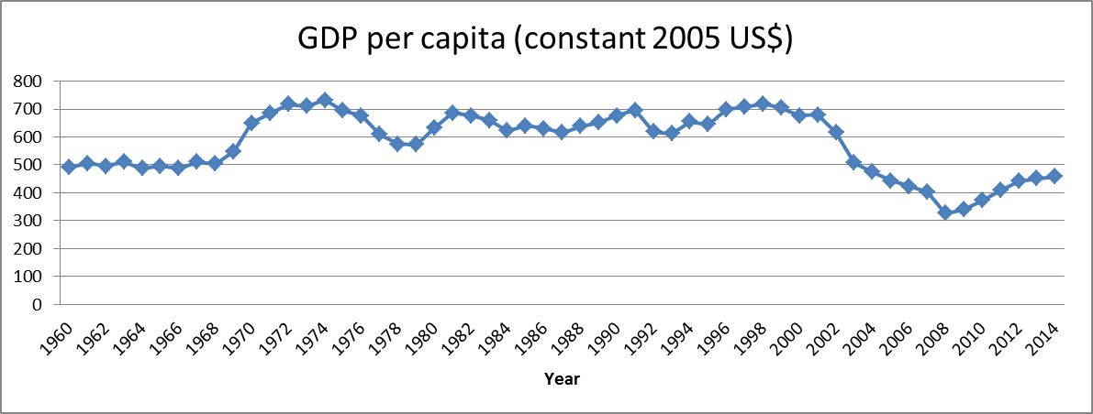

Slide 43
Growth in Real GDP and Employment (1980-2012)

Slide 44
Unsustained Economic Rebound
Cumulative economic decline of at least 51% during 1999-2008: (48% between 2000 and 2008), Zimbabwe declined from the 2nd largest economy in SADC to 11th.
The adoption of a multi-currency regime and cash budgeting, and discontinuation of quasi-fiscal operations of the RBZ in 2009 killed off hyperinflation and helped restore price stability;
Having averaged 10% during the period 2009-2012, growth declined to an estimated 4.5% in 2013, 3.8% in 2014, a projected 1.5% in 2015, reflecting the liquidity shortages in the economy, low domestic savings, investment inflows, power supply shortages and drought; against ZimAsset targets of 6.1% in 2014 and 6.4% in 2015.
Economic rebound since 2009 was anchored by mining and agriculture, with mining emerging as the most dynamic sector, replacing the role of agriculture in the pre-crisis Zimbabwe.

Slide 45
Declining Growth
Projected modest growth of 1.5% in 2015, driven by tourism, construction and communication, with some setbacks in agriculture and mining.
GDP growth in 2016 has been revised downwards from 2.7% to 1.2%. IMF and the World Bank have both revised the 2016 growth rate down to 1.4% and 1.5% respectively
The 2016 Budget based on assumption of successful resolution of Zimbabwe’s external payment arrears, significant reduction in the perceived country risk premium that made credit lines to Zimbabwe unaffordable; and the country being able to access credit lines at competitive rates – improved liquidity conditions.
IMF and the World Bank have both revised the 2016 growth rate down to 1.4% and 1.5% respectively
Experience suggests that it is difficult to get out of a deflation.

Slide 46
Key Economic Challenges (2014 Budget Statement)
High consumption, leading to negative domestic savings and, hence, exposing the country to rely on external savings;
• Liquidity constraint reflected in declining money supply growth, low financial intermediation and resulting in weak aggregate demand;
• High debt overhang resulting in limited and highly priced lines of credit;
• Limited external inflows in the form of foreign direct investment, lines of credit and grants linked to high country risk premium resulting in low confidence by investors;
• Food insecurity owing to low productivity, low investment, as well as climate change induced droughts and erratic rainfall distribution pattern;

Slide 47
Lack of industry competiveness due to obsolete equipment and out-dated technology as well as dumping and smuggling imposing unfair playing field with external competitors;
Infrastructure deficits, in particular transport, energy and water, resulting in high cost of doing business and, hence, lack of competitiveness;
Financial sector vulnerabilities stemming from weak governance, low interbank market activity, high non-performing loans (15.9% on average), low capitalisation and poor asset quality in several banks;
Lack of transparency and accountability in the exploitation of our mineral resources;
Widening current account deficit due to faster growth of imports than exports leading to haemorrhaging of the economy.

Slide 48
Way Forward
The economic rebound is projected to moderate up to 2017;
Compared to other African countries, the Zimbabwean economy remains highly differentiated, with a broad-based potential for recovery in all sectors, from mining to agriculture, manufacturing and services.
In this current phase of recovery, the mining sector is emerging as the main sector capable of autonomous growth.
The restructured agricultural sector also has potential of supply-response to improved conditions, as well as tourism.
However, growth in the manufacturing sector appears more dependent on the internal demand generated by the two main driving sectors (agriculture and mining).
Hence, the quality of policy in the mining and agricultural sector will in the main be the major determinants of the rate of growth of the economy.

Slide 49
Economic complexity is measured by the set of capabilities present in a country (ILO, 2016)

Slide 51
Success factors: consider a mix between three key strategies, based on a solid understanding of production capabilities (ILO, 2016).

Slide 52
Schematic illustration of linkages in the post-crisis Zimbabwean economy (World Bank, 2012)

Slide 53
Three growth levers: within-sector productivity growth, intersectoral reallocation, and firm dynamics (ILO, 2016)
Intra-sectorial structural change: The main driver of growth –in particular in manufacturing (often seen as an unconditional escalator to development): that is why the decline of manufacturing output in Zimbabwe is perhaps the main structural concern.
•Inter-sectorial structural change: Particularly important for countries rising from low to middle-income status: workers and capital migrate from less productive (agriculture, informality) to more productive (manufacturing, tradeable services) activities.
•Firm dynamics increases mean productivity by improving the distribution of firms in favourof relatively productive ones. In industrialized countries, entry of above-mean productivity firms contributes positively to aggregate productivity growth, while among developing and transitional economies there are several occurrences of negative contributions.

Slide 54
There is plenty of potential to turn the trend around and find new and strengthen existing sources of sustainable growth (ILO, 2016).
Agriculture: Regain lost productivity and strengthen linkages to industry
•Mining: We missed the commodity boom, but the potential remains large
•Manufacturing: Highly correlated with agriculture –high potential for regaining ground
•Services: Focus on areas of high potential –tourism, infrastructure, financial services

Slide 56
THANK YOU!

